Slide 1
Session 28
Remote Method Invocation (RMI)

Slide 2
Review
Java Database Connectivity (JDBC) Application Programming Interface (API) is a part of the Java APIs provided by Sun Microsystems that defines a set of API objects and methods to interact with databases.
The JDBC classes are present in the java.sql package and all Java programs that need to interact with databases use methods from this package.
The driver is loaded into the Java interpreter using the Class.forName() method.
Establish a connection using the getConnection() method of DriverManager class and use the createStatement() method of the Connection object .
Finally, SQL statements are constructed and executed through the statement instance by using either executeQuery() or executeUpdate() methods.
The PreparedStatement interface allows us to create pre-compiled SQL statements and gives us the option of specifying the parameters for the statement at a later stage.
ResultSet can be scrollable or non scrollable and first(), last(), afterLast(), beforeFirst() are some of the methods for moving the cursor in result set.

Slide 3
Objectives
Explain the Java Distributed Object Model
Describe RMI
Explore the RMI architecture
Discuss the java.rmi package
Describe a sample RMI application

Slide 4
Introduction
Large problems can be solved easily if they are split among two or more people.
Distributed computing helps to solve large problems by splitting them.
The split components are kept in different computers.
Objects on remote systems can be accessed with the same ease as those on local systems.
Advantages of distributed object systems are scalability, minimizing bandwidth requirements and making it easier for the programmer by handling or hiding complexities across systems.

Slide 5
RMI
Remote
Java
Object
Remote
Java Object
Remote
Java Object
RMI/RMI-IIOP
RMI allows objects in one JVM to invoke methods of objects in another JVM.
Distributed object systems require that objects running in different address spaces be able to communicate with each other.
Client invoking methods of remote Java objects

Slide 6



RMI Architecture 2-1
3 layers in RMI system
Stub – proxy for remote object.
Skeleton – remote proxy
for object.
Stub/ Skeleton layer
Remote reference layer -Supports communication between stub and skeleton.
Remote reference layer
Transport Layer - Sets up and manages connections
between different JVMs.
Transport layer

Slide 7
RMI Architecture 2-2
Client
Server
Application
Application
Stub Layer
Skeleton Layer
Remote Reference
Layer
Remote Reference
Layer
Network
Transport Layer
Transport Layer

Slide 8
Stub and Skeleton layer
A client needs a reference to the remote object to invoke any of its methods.
Invocation passes from stub to remote reference layer to transport layer.
Transport layer contacts the skeleton through remote reference layer on the server.
Skeleton checks remote registry to see whether the object is registered.
If registered, the object method is passed to the stub using remote reference layer and transport layer and then to the client object.

Slide 9
Remote Reference Layer
Responsible for unicast point-to-point method invocation.
It defines the number of connections that can be made to a server object depending on the load on the server object.
May deactivate an object and store the data of the object in a file or a database.
If the server is down, try to look out for alternatives to fulfill a request.

Slide 10
Transport Layer
RMI uses TCP/IP to communicate between client and server transport layers.
It uses socket to communicate between the client and server transport layer.
Transport layer can implement TCP and UDP protocols.
Transport layer takes care of multiple connections from the client.

Slide 11
Remote Registry
Remote
registry
Maintains a
database
Server objects
Objects accessed
remotely
Object name

Slide 12
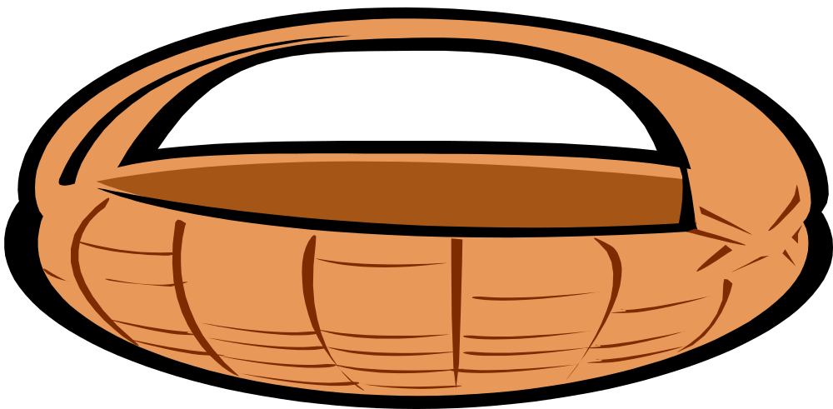
Packages of RMI
The RMI API has mainly five packages:
java.rmi
java.rmi.dgc
java.rmi.registry
java.rmi.activation
java.rmi.server

Slide 13
java.rmi package
This package declares the Remote interface, the MarshalledObject, the Naming and RMISecurityManager classes and a number of exceptions.
Remote interface:
  Must be implemented by all remote objects.
  The interface does not have any methods.
  Used only to indicate that the class which implements this interface can be accessed remotely.
MarshalledObject class:
  Maintains serialized byte stream of the object.
Naming class:
  Provides static functions like bind(), rebind() and lookup() for accessing remote objects using RMI.

Slide 14
java.rmi.registry package
Registry interface:
  Has methods used for storing and retrieving the references of remote objects.
RegistryHandler:
  Has methods for accessing objects that implement the Registry interface.
LocateRegistry:
  Has overloaded static method getRegistry() for retrieving Registry objects on server host.

Slide 15
java.rmi.server package 2-1
RemoteObject class:
  Implements the Remote interface.
RemoteServer:
  Provides general functions of a server.
UnicastRemoteObject:
  Provides default remote object implementation.
RemoteStub:
  Provides general implementation of client side stubs.

Slide 16
java.rmi.server package 2-2
Skeleton interface:
  It is implemented by Remote skeletons .
RMIClassLoader:
  Supports the loading of classes remotely.
RMISocketFactory:
  Used to specify a socket implementation for transporting information between clients and servers.

Slide 17
java.rmi.activation 2-1
Activatable class:
  Provides support for remote objects that require persistent access and can be activated by the system.
ActivationGroup:
  Responsible for creating new instances of “activatable” objects.
  Informs ActivationMonitor when its objects becomes either active or inactive.
ActivationGroupDesc:
  Contains information necessary to create/recreate an activation group.

Slide 18
java.rmi.activation 2-2
ActivationGroupDesc.CommandEnvironment:
  Provides Startup options for ActivationGroup implementations.
ActivationGroupID:
  Creates a registered activation group that serves the following purposes:
    Identifies the group uniquely within the activation system.
    Contains a reference to the activation system of the group.
Activation ID:
  Makes use of special identifiers to denote remote objects that can be activated over time.

Slide 19
java.rmi.dgc
DGC interface:
  Used for the server side of the Distributed Garbage Collection algorithm.
Lease class object:
  Contains a unique VM identifier and a lease duration.
VMID class object:
  An identifier that is unique across all Java virtual machines.

Slide 20
Implementing a Quiz Project
Involves implementing the RMI client and RMI server.
Steps involved include:
  Create the remote interface.
  Create a class that implements the Remote interface.
  Create the stub and skeleton classes.
  Copy the remote interface and stub file to the client.
  Create and register the Remote Object.

Slide 21
Create the Remote Interface
Remote objects are always referenced through an interface.
The objects have method definitions in the interface that the client object can call.
The interface must be public and should extend the Remote interface.
The methods defined should throw a RemoteException.
The remote interface has one method getDetails() that takes an SQL statement in the form of a String argument and returns the data set in the form of an object array.

Slide 22
Example
//Remote Interface
import java.rmi.*;
import java.sql.SQLException;
import java.sql.*;
public interface ServerInterface extends Remote
{
public Details[] getDetails(String sql) throws RemoteException, SQLException ;
}

Slide 23
Class to implement Remote Interface
Classes that implement the remote interface generally extend the UnicastRemoteObject.
The class is registered with the Remote registry using the rebind() method of the Naming class.

Slide 24
Example (Server Class) 3-1
// Server
import java.rmi.*;
import java.net.*;
import java.rmi.server.*;
import java.sql.*;
public class Server extends UnicastRemoteObject implements ServerInterface
{
public static String url, sql;
public static Connection con;
public static Statement stmt;
public Server() throws RemoteException
{
try
{
Class.forName("sun.jdbc.odbc.JdbcOdbcDriver");
}
catch(ClassNotFoundException ce)
{
System.out.println(ce);
}
try
{
url = "jdbc:odbc:test";
con = DriverManager.getConnection(url, “sa”, “playware”);
stmt = con.createStatement();
}

Slide 25
Example (Server Class) 3-2
catch(SQLException ce)
{
System.out.println(ce);
}
}
public static void main(String [] args)
{
try
{
Server server = new Server();
Naming.rebind("QuizServer", server);
System.out.println("Server is ready and running.....");
}
catch (Exception ex)
{
ex.printStackTrace();
}
}
public Details[] getDetails(String sql) throws SQLException
{
Details[]data = Details.getInstance(con,sql);
System.out.println(data[0].question);
return data;
}
}

Slide 26
Example (Details class) 3-3
public static Details[] getInstance(Connection con,String sql) throws SQLException
{
Vector vect = new Vector();
Statement stmt = con.createStatement( );
ResultSet rs = stmt.executeQuery(sql);
while(rs.next())
{
int mqno = rs.getInt(1);
String mquestion = rs.getString(2);
String m_ans1 = rs.getString(3);
String m_ans2 = rs.getString(4);
String m_ans3 = rs.getString(5);
String m_ans4 = rs.getString(6);
String mcorrectans = rs.getString(7);
Details data = new Details(mqno, mquestion, m_ans1, m_ans2, m_ans3, m_ans4, mcorrectans);
vect.addElement(data);
}
rs.close();
stmt.close();
int num = vect.size();
Details[] data = new Details[num];
for(int i = 0; i < num; i++)
{
data[i] = (Details) vect.elementAt(i);
}
return data;
}}
import java.sql.*;
import java.io.Serializable;
import java.util.Vector;
public class Details implements Serializable
{
int qno;
String question;
String ans1;
String ans2;
String ans3;
String ans4;
String correctans;
public Details(int mqno, String mquestion, String m_ans1, String m_ans2, String m_ans3, String m_ans4, String mcorrectans)
{
qno = mqno;
question = mquestion;
ans1 = m_ans1;
ans2 = m_ans2;
ans3 = m_ans3;
ans4 = m_ans4;
correctans = mcorrectans;
}

Slide 27
Create the stub and skeleton classes
Stub and skeleton class have to be registered with the remote registry.
For registering, the tool rmic compiler has to be used.
Syntax for the usage of the rmic tool is:
  rmic packagename.classname
Run the compiler in the directory that has the Server.class program.
  rmic Server
Server_Stub.class and Server_Skel.class files are generated.

Slide 28
Copy Stub And Skeleton classes to the Client
Remote interface and the stub file have to be copied to a directory, which is in the classpath of the client machine.
In this example, ServerInterface.class and Server_Stub.class have to be copied to the client machine.
If it is tested in the same machine then just copy the two files to a directory, which is in the classpath.

Slide 29
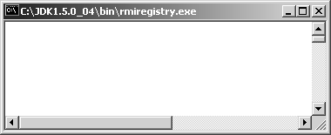
Create and register the remote object
Start the RMI registry by executing the following command once the Skeleton and Stub are generated.
  start rmiregistry
A new empty command prompt is displayed.
Execute the Server.class in another command prompt.
  java Server

Slide 30
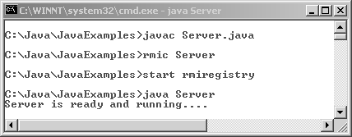
Output

Slide 31
Implementing the RMI client
Call the remote interface using the lookup() method of the Naming class.
The client can now call any of the methods in the remote interface.

Slide 32
Example (RMI Client) 4-1
//RMI Client
import java.awt.*;
import java.awt.event.*;
import java.sql.*;
import java.util.*;
import java.rmi.*;
public class RemoteClient extends Frame implements ActionListener, ItemListener
{
public static final String URL = "rmi://127.0.0.1/QuizServer";
String sql;
Details[] data1;
Details[] data2;
int score=0;
ServerInterface theServer;
CheckboxGroup cg = new CheckboxGroup();
Checkbox chkName1 = new Checkbox("",cg,false);
Checkbox chkName2 = new Checkbox("",cg,false);
Checkbox chkName3 = new Checkbox("",cg,false);
Checkbox chkName4 = new Checkbox("",cg,false);
Button nextbtn = new Button("Next");
Button exitbtn = new Button("Exit");
Panel panel1 = new Panel();
Panel panel2 = new Panel();
Label lblName1 = new Label("");
Label lblName2 = new Label("");
Label lblName3 = new Label("");
Label lblName4 = new Label("");

Slide 33
Example (RMI Client) 4-2
String qn, ans1, ans2, ans3, ans4, selectedans, correctans;
int num = 1, qno, questions, index = 0;
ResultSet rs;
public RemoteClient(String title)
{
super(title);
setLayout(new BorderLayout());
panel1.setLayout(new GridLayout(7,1));
lblName1.setFont(new Font("Helvetica",Font.BOLD,16));
nextbtn.setFont (new Font("Lucida Regular",Font.BOLD,16));
exitbtn.setFont(new Font("Lucida Regular",Font.BOLD,16));
chkName1.addItemListener(this);
chkName2.addItemListener(this);
chkName3.addItemListener(this);
chkName4.addItemListener(this);
chkName1.setFont(new Font("Helvetica",Font.BOLD|Font.ITALIC,14));
chkName2.setFont(new Font("Helvetica",Font.BOLD|Font.ITALIC,14));
chkName3.setFont(new Font("Helvetica",Font.BOLD|Font.ITALIC,14));
chkName4.setFont(new Font("Helvetica",Font.BOLD|Font.ITALIC,14));
lblName2.setFont(new Font("Lucida",Font.BOLD,12));
lblName3.setFont(new Font("Lucida",Font.BOLD,12));
lblName3.setForeground(Color.blue);
panel1.add(lblName2);
panel1.add(lblName3);
panel1.add(chkName1);
panel1.add(chkName2);

Slide 34
Example (RMI Client) 4-3
panel1.add(chkName3);
panel1.add(chkName4);
panel2.add(nextbtn);
panel2.add(exitbtn);
panel2.setBackground(Color.black);
panel2.setForeground(Color.blue);
panel1.setSize(500,200);
panel2.setSize(500,300);
add("Center",panel1);
add("South",panel2);
pack();
nextbtn.addActionListener(this);
exitbtn.addActionListener(this);
try
{
theServer =(ServerInterface) Naming.lookup(URL);
}
catch(Exception e)
{
}
try
{
sql = "Select * from quiz order by Qno";
data2 = theServer.getDetails(sql);
questions = data2.length;
display();
}
catch(Exception ce)
{
System.out.println(ce);
}
}
public void actionPerformed(ActionEvent e)
{
if (index==(questions-2))
//Last but one question
nextbtn.setEnabled(false);
if (e.getSource().equals(nextbtn))
{
index++;
display();
}
else
{
if(e.getSource().equals(exitbtn))
{
System.out.println("You scored : " + score);
System.exit(0);
}
}
}

Slide 35
Example (RMI Client) 4-4
public void itemStateChanged(ItemEvent e)
{
String answer = ((Checkbox)e.getSource()).getLabel();
if(answer.trim().equals(data2[index].correctans.trim()))
score+=25;
}
public static void main(String args[])
{
RemoteClient quizclient = new RemoteClient("Online Quiz");
quizclient.setSize(500,300);
quizclient.setVisible(true);
}
public void display()
{
qno = data2[index].qno;
qn = data2[index].question;
ans1 = data2[index].ans1;
ans2 = data2[index].ans2;
ans3 = data2[index].ans3;
ans4 = data2[index].ans4;
correctans = data2[index].correctans;
lblName2.setText("Question "+qno);
lblName3.setText(qn);
chkName1.setLabel(ans1);
chkName2.setLabel(ans2);
chkName3.setLabel(ans3);
chkName4.setLabel(ans4);
chkName1.setState(false);
chkName2.setState(false);
chkName3.setState(false);
chkName4.setState(false);
}
}

Slide 36
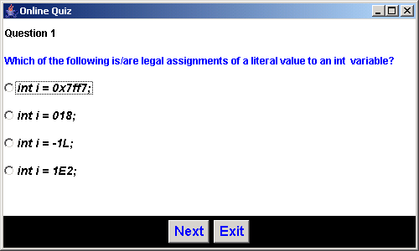

Output
The rmiregistry and the server program should be running before the client program is run.

Slide 37
Summary 3-1
The distributed object model used by Java allows objects in one JVM to invoke methods of objects in a separate JVM. These separate JVMs may execute as a different process in the same computer or on a remote computer.
The RMI system consists of three layers in its architecture, namely:
  The stub/skeleton layer
  The remote reference layer
  The transport layer

Slide 38
Summary 3-2
For implementing RMI we need to implement RMI Server and then the RMI Client. The steps involved in creating and registering a remote object are:
  Create the remote interface.
  Create a class that implements the remote interface.
  Create the stub and skeleton classes.
  Copy the remote interface and stub file to the client.
  Create and register the remote object.

Slide 39
Summary 3-3
The RMI Server should be running before the client program is run. The tool used to create the stub and skeleton is rmic. The usage of rmic is given below:
rmic packagename.classname
This creates two files, namely: classname_Stub.class and classname_Skel.class
The Naming class is used to register and look up the remote object.

